Slide 1
FINAL PROJECT DEMONSTRATION • DIGITAL LOGIC DESIGN
Design of a 4:1 Multiplexer
and Its Extension to an 8:1 Multiplexer
MULTIPLEXER ARCHITECTURE
D0
TEAM MEMBERS
D1
4:1
MUX
M. Kaushik
2620030699
Y
D2
P. Bhanu Charan
2620030698
D3
G. Sriteja
2620030700
Select lines: S₁, S₀
D.Hemaswini
2620030673
SECTION: [INSERT SECTION]
A combinational circuit that routes one selected input to an output.

Slide 2
01 / OVERVIEW
Introduction & Objective
Multiplexers are fundamental combinational circuits used for digital data selection.
WHAT IS A MUX?
4:1 MULTIPLEXER
8:1 MULTIPLEXER
A multiplexer (MUX) selects one of several data inputs and forwards it to one output.
4 data inputs • 2 select bits • 1 output
Number of choices = 2² = 4.
8 data inputs • 3 select bits • 1 output
Number of choices = 2³ = 8.
PROJECT OBJECTIVES
SELECT-LINE CAPACITY
• Design and verify a 4:1 multiplexer using logic gates.
2
2² = 4
four input choices
• Extend the design to select among eight data inputs.
3
2³ = 8
eight input choices
• Validate input-selection behavior through Logisim simulation.
02/06

Slide 3
02 / LOGIC
Theory & Logic Circuit
NOT gates generate complemented select signals; AND gates enable paths; OR combines them.
4:1 BOOLEAN EXPRESSION
4:1 GATE-LEVEL STRUCTURE
Y = D₀S₁′S₀′ + D₁S₁′S₀ + D₂S₁S₀′ + D₃S₁S₀
D0
AND ×3
8:1 SELECTION RULE
D1
AND ×3
OR ×4
Y
Y = Dₖ, where k is the binary value of S₂S₁S₀ (000 → D₀, …, 111 → D₇).
D2
AND ×3
D3
AND ×3
GATES USED
• 4:1: two NOT, four 3-input AND, one 4-input OR
• 8:1 direct gate build: three NOT, eight 4-input AND, one 8-input OR
Each AND term corresponds to one select combination. Only the selected path can pass its data bit.
Conceptual diagram — not a Logisim screenshot.
03/06

Slide 4
03 / IMPLEMENTATION
Circuit Design in Logisim
Two 4:1 multiplexers feed a final 2:1 selection stage to form an 8:1 MUX.
8:1 MUX ARCHITECTURE
1 • PLACE PINS
Data inputs D0–D7, select pins S0–S2, and output Y.
D0
MUX A
4:1
D1
D2
2 • CONNECT STAGES
2:1 MUX
D3
Share S1 and S0 across both 4:1 blocks; use S2 for final selection.
D₀–D₃
Y
D4
MUX B
4:1
D5
3 • SIMULATE
D6
Toggle inputs with the Poke tool and verify output Y.
D7
D₄–D₇
S₁,S₀ → both 4:1 blocks • S₂ → final 2:1 stage
[INSERT ACTUAL LOGISIM CIRCUIT SCREENSHOT]
04/06

Slide 5
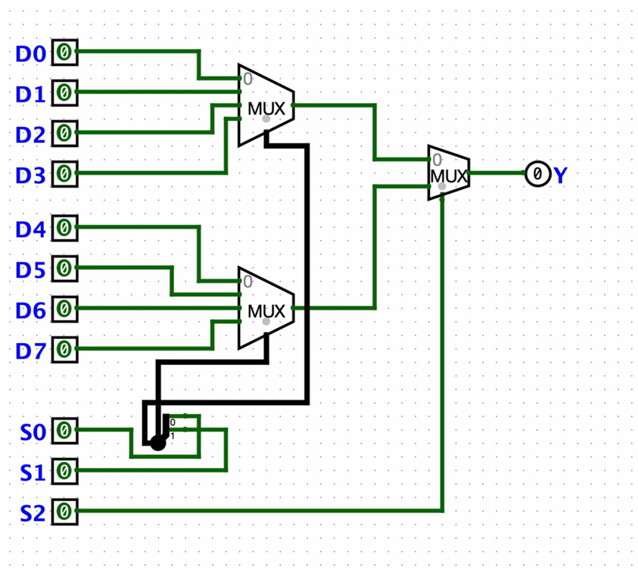

Slide 6
04 / VERIFICATION
Simulation Results
Truth tables define the expected output; insert real Logisim captures after testing.
4:1 MULTIPLEXER
8:1 MULTIPLEXER
S₁
S₀
Selected input
S₂
S₁
S₀
Selected input
0
0
D₀
0
0
0
D0
0
0
1
D1
0
1
D₁
0
1
0
D2
1
0
D₂
0
1
1
D3
1
1
D₃
1
0
0
D4
1
0
1
D5
1
1
0
D6
EXAMPLE TEST CASE
1
[INSERT ACTUAL LOGISIM SIMULATION SCREENSHOT(S)]
1
1
D7
S₂S₁S₀ = 101 selects D₅.
If D₅ = 1, then Y = 1.
Show a 4:1 test and an 8:1 test with select pins and output Y visible.
Note: the truth table identifies which data input is selected; Y equals that input’s current logic value.
05/06

Slide 7
05 / TAKEAWAYS
Conclusion & Applications
A multiplexer scales data selection efficiently using a small number of select lines.
CONCLUSION
DESIGN INSIGHT
A 4:1 MUX selects one of four inputs with two select bits. An 8:1 MUX selects one of eight inputs with three select bits.
Two 4:1 MUX blocks plus a 2:1 stage create an 8:1 MUX; alternatively, use a direct gate-level implementation.
APPLICATIONS
POSSIBLE IMPROVEMENTS
Data routing
Processors
Choose one source for a shared line.
Select registers or operands.
• Package MUX designs as reusable subcircuits.
• Test all select combinations and data patterns.
• Compare gate-level and built-in MUX implementations.
Communication
Digital control
Switch among signals or channels.
Implement selection functions.
Before presenting: replace both screenshot placeholders with captures from your own Logisim simulation.
06/06

